Slide 1
2012 Workplace Fatalities Analysis
Ousman Njie
Project 1
Bootcamp: Quick Start Data Science & Analytics

Slide 2

Table of Content
Introduction
Overview of Dataset
Fatalities Analysis
Injuries/Illnesses Analysis
Penalties Analysis
Key observations
Conclusion
Q&A

Slide 3
Introduction
Purpose: This presentation aims to analyze 2012 workplace safety statistics across various states, focusing on fatalities, injuries, and penalties. We'll explore trends, disparities, and implications for policy and enforcement.

Slide 4
Data Overview
Fatalities: The total number of workplace fatalities recorded in each state during the specified period.
Injuries/Illnesses: The total number of workplace injuries and illnesses reported in each state.
Penalties: The average monetary penalties imposed on workplaces for safety violations.

Slide 5
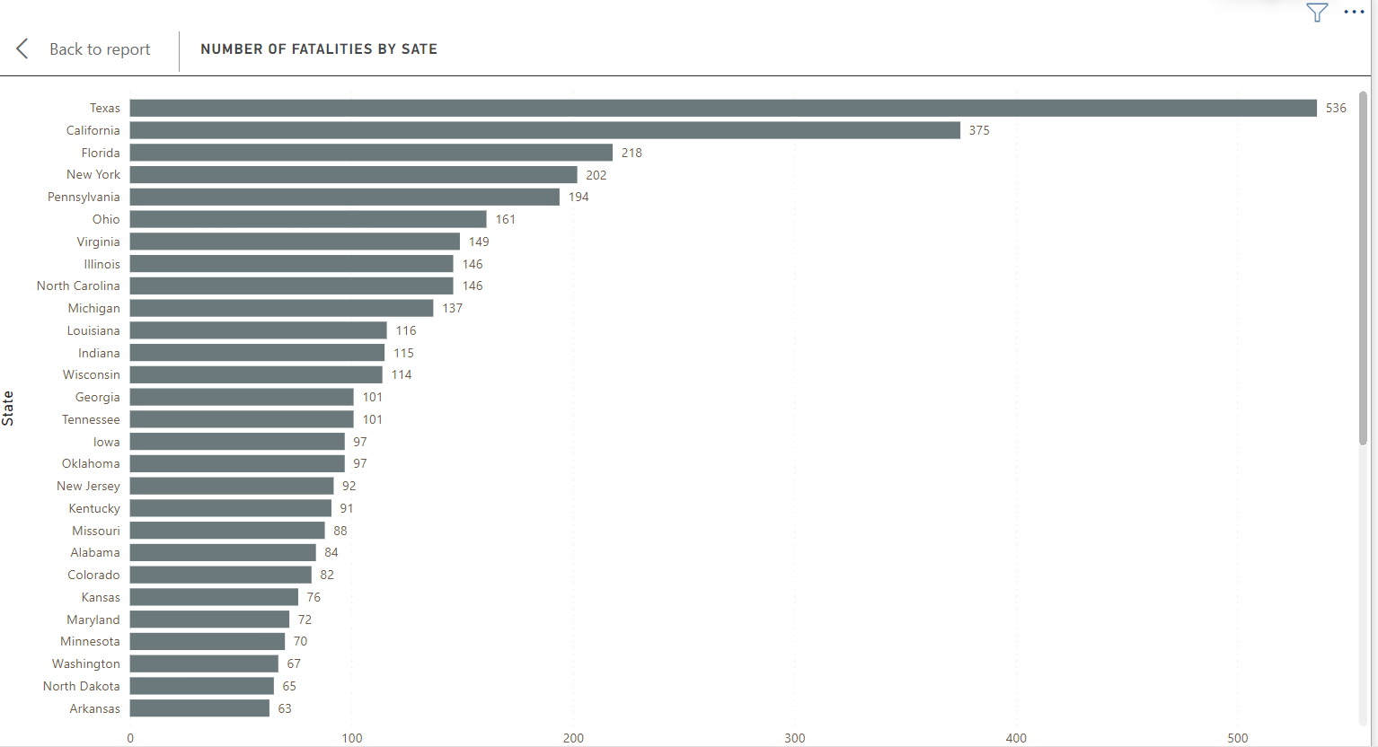
Fatalities Analysis
States with the Highest Fatalities
Texas | 536
California | 375
Florida | 218
New York | 202
Pennsylvania | 194
States with the lowest Fatalities
Maine | 19
Delaware | 14
New Hampshire | 14
Vermont | 11
Rhode Island | 8

Slide 6
Injuries/Illnesses Analysis
States with the highest injuries/ illnesses
States with the lowest injuries/ illnesses
State | Number of injuries/illnesses | Type of program
California | 345400 | State
Texas | 203200 | Federal
Pennsylvania | 155300 | Federal
New York | 146300 | Federal
Illinois | 124900 | Federal
State | Number of injuries/illnesses | Type of program
Montana | 13300 | Federal
Vermont | 9900 | State
Alaska | 9700 | State
Delaware | 7900 | Federal
Wyoming | 6500 | State

Slide 7
Penalties Analysis
States with the highest average penalties
States with the lowest average penalties
California | $6422
Kentucky | $3254
North Dakota | $3045
Arkansas | $2569
Nebraska | $2565
Virginia | $726
Maryland | $685
Michigan | $542
South Carolina | $492
Oregon | $363

Slide 8
Key Observations
Regional Disparities- states in the Midwest and South appear to have higher rates of fatalities compared to states in other regions
Injury Count- Federal programs have higher numbers of injuries and illnesses
Number of inspectors- Federal programs had more inspectors per state than state programs, allowing for more frequent inspections and oversight.
Average Penalties imposed- State programs imposed lower average penalties than federal programs, which could lead to potential differences in enforcement strategies and priorities.

Slide 9
Conclusion
The analysis of 2012 workplace safety statistics reveals significant variations across states, indicating diverse safety landscapes and enforcement practices.

Slide 10
Thank you
Ousman Njie
manaous7@gmail.com

